Slide 1


<Debopam Das>
<12-15-25>

Slide 2

Outline
Executive Summary
Introduction
Methodology
Results
Conclusion

Slide 3
Executive Summary
Summary of methodologies
------------------------------------------------
• Data collection • Data wrangling • Exploratory Data analysis with Data visualization • Exploratory Data analysis with SQL • Building an interactive map with Folium • Building a plotly Dashboard • Predictive analysis
Summary of all results
------------------------------------------------
• Exploratory Data Analysis results • Interactive analytics • Predictive analysis results

Slide 4
Introduction
Project background and context
SpaceX is the most successful Space Transportation and aerospace Manufacturer company right now, making space exploration accessible. SpaceX advertises Falcon 9 rocket launches on their website. Its offering the launch at as low as 62 million dollars, which is significantly lower than other providers. Much of the savings is because SpaceX can reuse the first stage. Hence if we can assess if the first stage will land, we can calculate the expense of a launch.Based on data provided and models we can predict the outcomes and future usage of the first stage.
Problems you want to find answers
Finding out all the factors influencing landing outcome.
How different variables(launch site, number of flights, etc.) affects the success of the first stage.
Conditions needed to increase the probability of successful landing

Slide 5

Section 1

Slide 6
Methodology
Executive Summary
Data collection methodology:
Using SpaceX Rest API
Web Scrapping
Perform data wrangling
Filter the data
Fixing the missing values
Prepare data to a binary classification
Perform exploratory data analysis (EDA) using visualization and SQL
Perform interactive visual analytics using Folium and Plotly Dash
Perform predictive analysis using classification models

Slide 7
Data Collection
Data collection involved gathering and measuring data on different variables to get result. We used API requests from SpaceX REST API and Web scraping. Firstly, we used get request using API to parse the SpaceX launch data. Then we decode the response using .json() and turned it into a data frame. Requested Information about launches from SpaceX API by adding functions. Adding filter to the data frame to only include Falcon 9 launches. Then we cleaned the data and fill up missing and needed values. Exported the data to CSV.

Slide 8
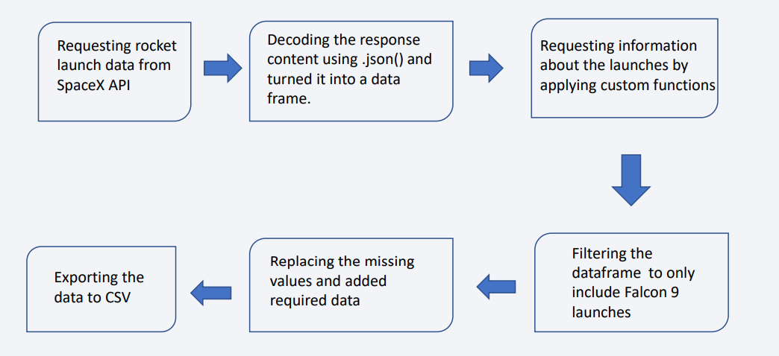
Data Collection – SpaceX API
https://github.com/dasdebopam/Coursera_data_sci_course/blob/main/capstone/jupyter_labs_spacex_data_collection_api_(1).ipynb

Slide 9
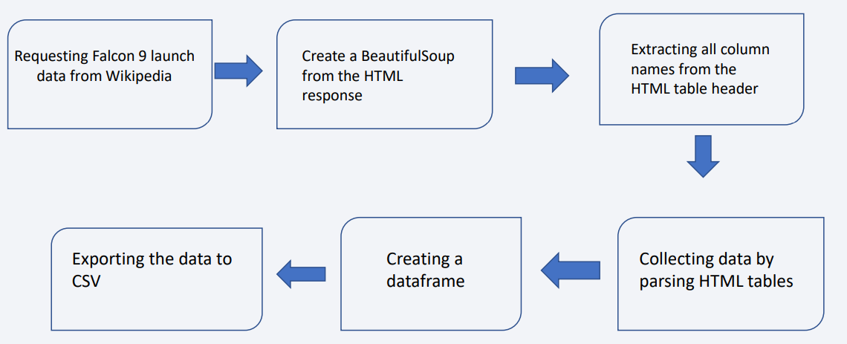
Data Collection - Scraping
https://github.com/dasdebopam/Coursera_data_sci_course/blob/main/capstone/jupyter_labs_webscraping.ipynb

Slide 10
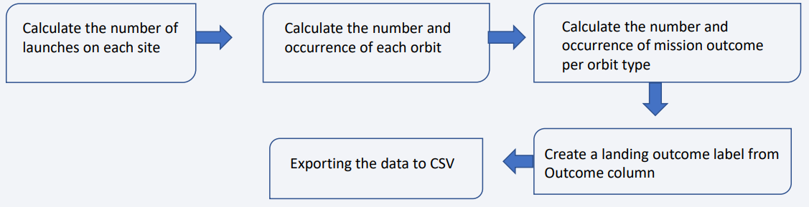
Data Wrangling
Data wrangling is the process of organizing, cleaning and converting data into a more suitable format. In the data set we first calculate the number of launches on each site, then we calculate the number and occurrence of each orbit. After that we calculate the number and occurrence of mission outcome per orbit type and created a landing outcome label from outcome column.
https://github.com/dasdebopam/Coursera_data_sci_course/blob/main/capstone/labs_jupyter_spacex_Data_wrangling.ipynb

Slide 11
EDA with Data Visualization
Visualize the relationship between Flight Number and Launch Site.
Visualize the relationship between Payload Mass and Launch Site.
Visualize the relationship between success rate of each Orbit Type.
Visualize the relationship between Flight Number and Orbit Type.
Visualize the relationship between Payload Mass and Orbit Type.
Visualize the launch success yearly trend.
Create dummy variables to categorical columns.
Cast all numeric columns to float64.
This includes Bar charts and Scatter plots and line charts showing relationships between different variables, as we got a idea if relationships from scatterplots we then interpret the relation between different aspects through bar graphs to determine which orbit have highest success rate. Then we usedthe line graph to show patterns overtime(Launch success yearly trend).Add the GitHub URL of your completed EDA with data visualization notebook, as an external reference and peer-review purpose
https://github.com/dasdebopam/Coursera_data_sci_course/blob/main/capstone/EDA_with_Visualization.ipynb

Slide 12
EDA with SQL
Displayed the names of the unique launch sites in the space mission.
Displayed 5 records where launch sites begin with the string ‘CCA’.
Displayed the total payload mass carried by booster launched by NASA(CRS).
Displayed the average payload mass carried by booster version F9 v1.1.
Listed the date when the first successful landing outcome in ground pad was achieved.
Listed the names of the boosters which have success in drone ship and have payload mass greater than 4000 but less than 6000.
Listed the total number of successful and failure mission outcomes.
Listed the names of the booster_versions which have carried the maximum payload mass.
Listed the records which will display the month names, failure landing_outcomes in drone ships, booster versions, launch_site for the months in the year 2015.
Ranking the count of landing outcomes between the date 2010-06-04 and 2017-03-20, in descending order.
https://github.com/dasdebopam/Coursera_data_sci_course/blob/main/capstone/EDAwithsql.ipynb

Slide 13
Build an Interactive Map with Folium
We then marked the success/ failed launches for each site on the map.
We build an interactive Map to visualize the launch data.
Added marker with circle, popup label and text label to show their geographical locations , proximity to equator line and coasts.
Calculated the distances between a launch sites to its proximities.
Added polyline to show distance between launch site and highway, railway ,closest city and coast
https://github.com/dasdebopam/Coursera_data_sci_course/blob/main/capstone/folium_lab.ipynb

Slide 14
Build a Dashboard with Plotly Dash
Created a Dashboard with plotly Dash (SpaceX Launch Records Dashboard)
• Added a dropdown to select launch site.
• Added pie chart to show successful launches while selecting all sites, and success and failure count when specific launch site was selected.
• To show payload range we added a slider.
• Added a scatter chart showing relation between payload and launch success
https://github.com/dasdebopam/Coursera_data_sci_course/blob/main/capstone/spacex_dash_app.py

Slide 15
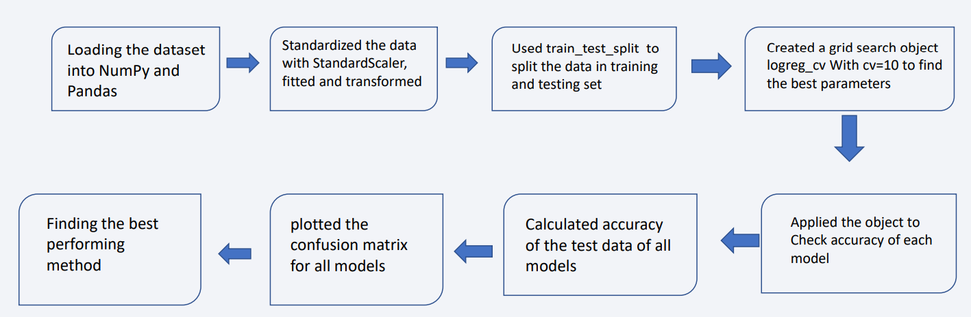
Predictive Analysis (Classification)
https://github.com/dasdebopam/Coursera_data_sci_course/blob/main/capstone/SpaceX_Machine_Learning_Prediction_Part_5.ipynb

Slide 16
Results
Exploratory data analysis results
Interactive analytics demo in screenshots
Predictive analysis results

Slide 17

Section 2

Slide 18
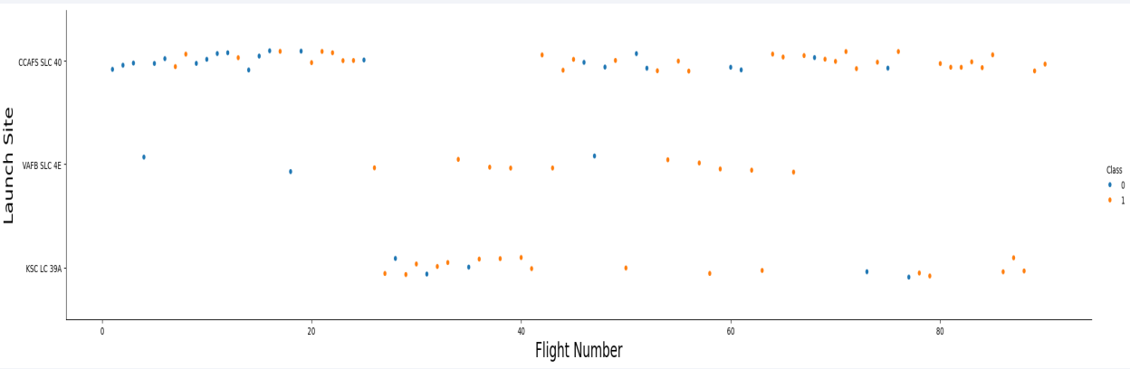
Flight Number vs. Launch Site

Slide 19
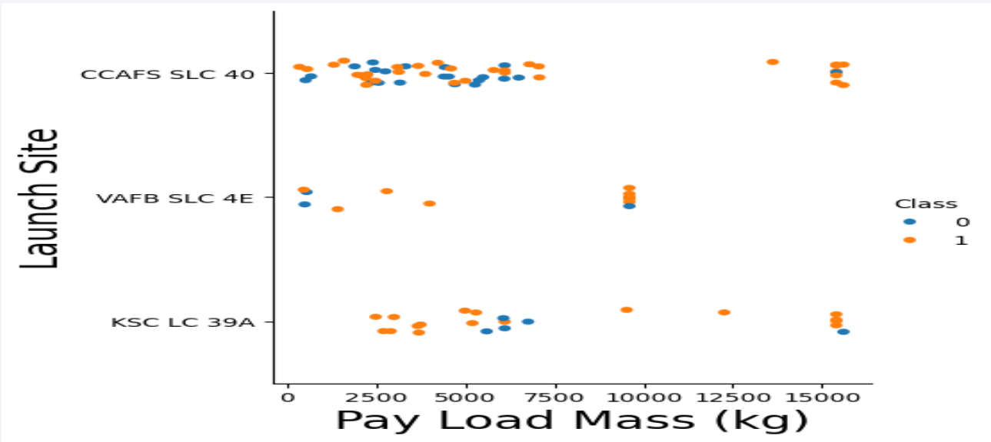
Payload vs. Launch Site

Slide 20
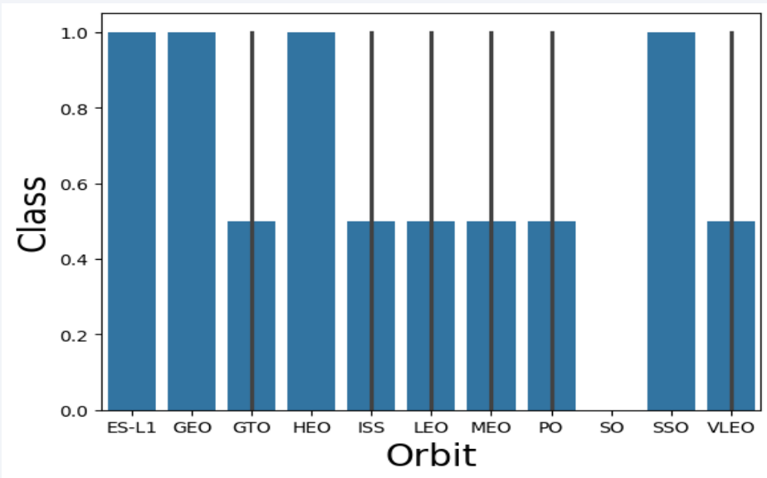
Success Rate vs. Orbit Type

Slide 21
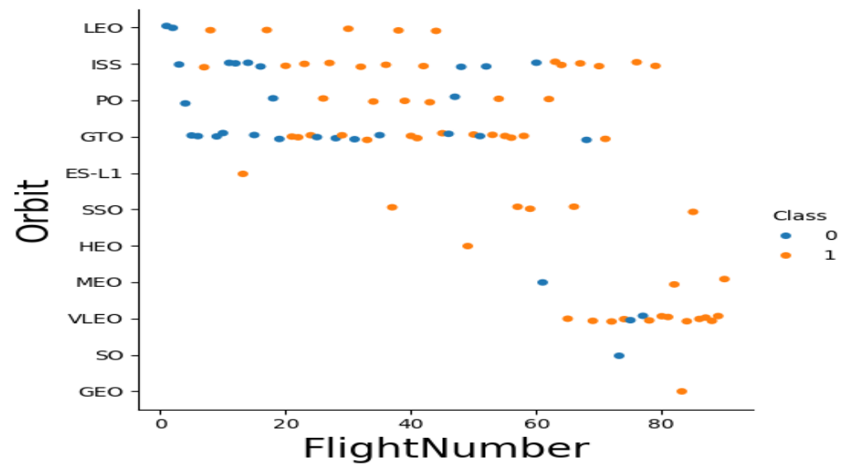
Flight Number vs. Orbit Type

Slide 22
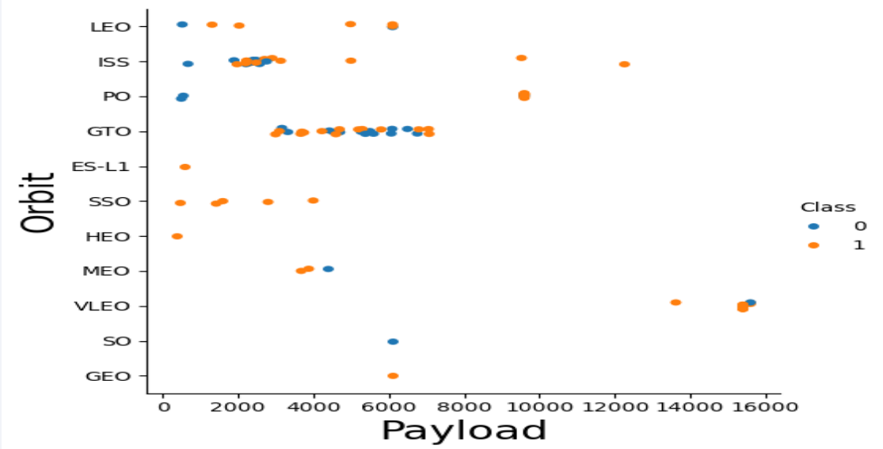
Payload vs. Orbit Type

Slide 23
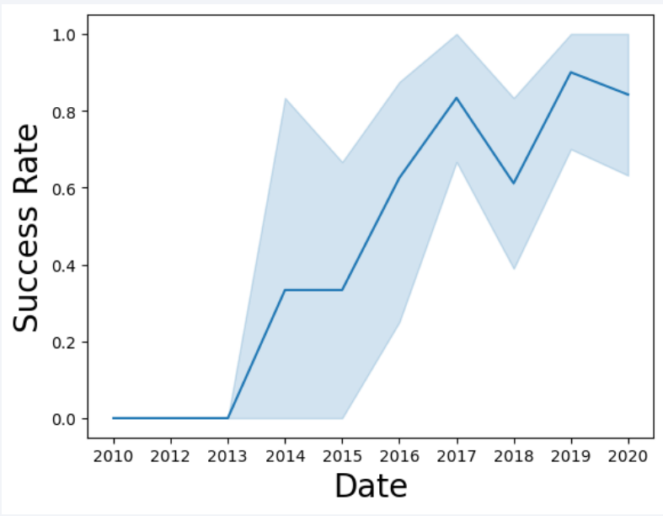
Launch Success Yearly Trend

Slide 24
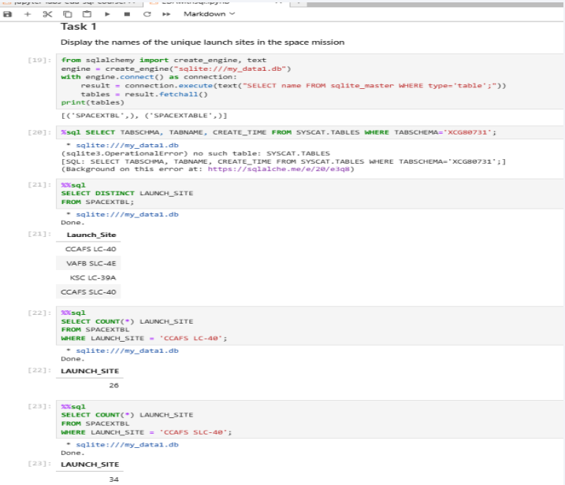
All Launch Site Names

Slide 25
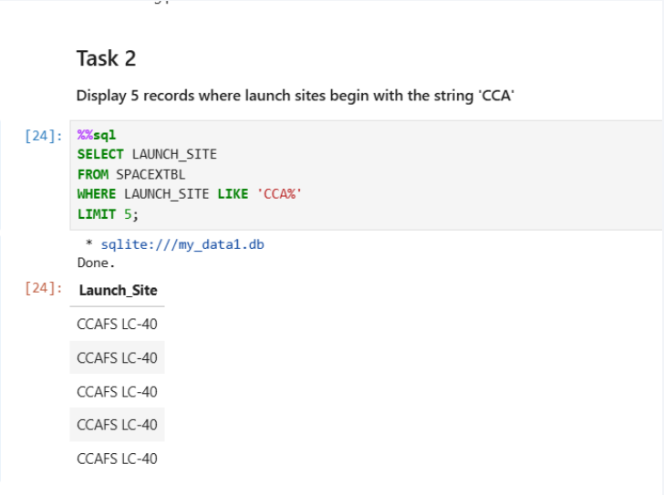
Launch Site Names Begin with 'CCA'

Slide 26
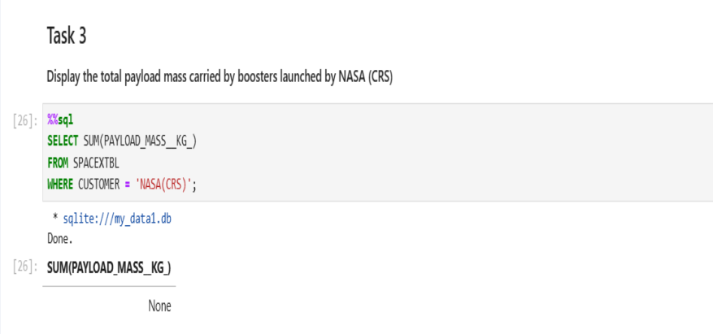
Total Payload Mass

Slide 27
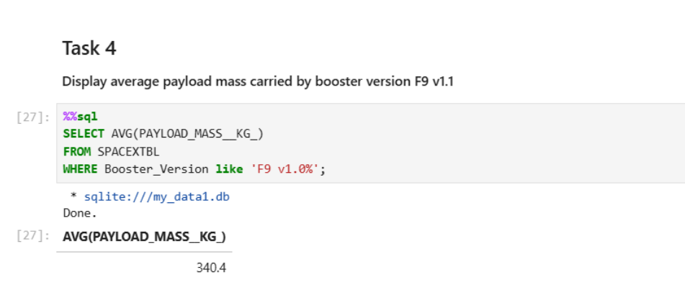
Average Payload Mass by F9 v1.1

Slide 28
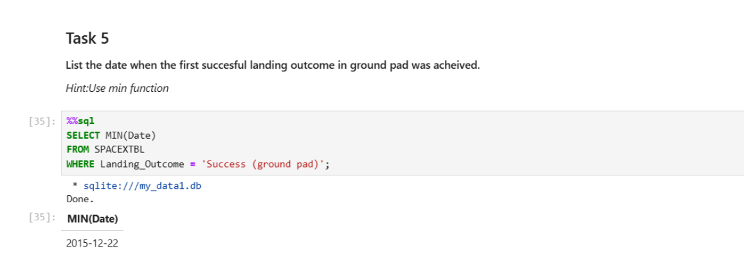
First Successful Ground Landing Date

Slide 29
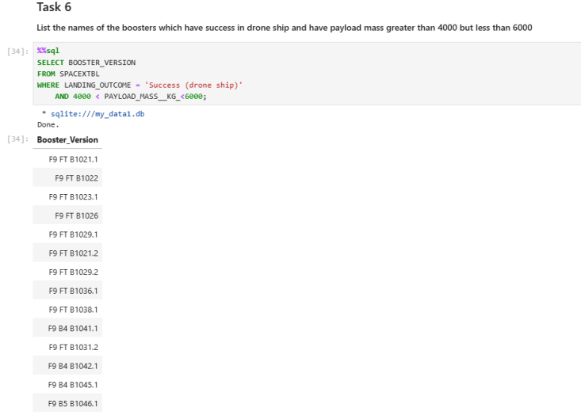
Successful Drone Ship Landing with Payload between 4000 and 6000

Slide 30
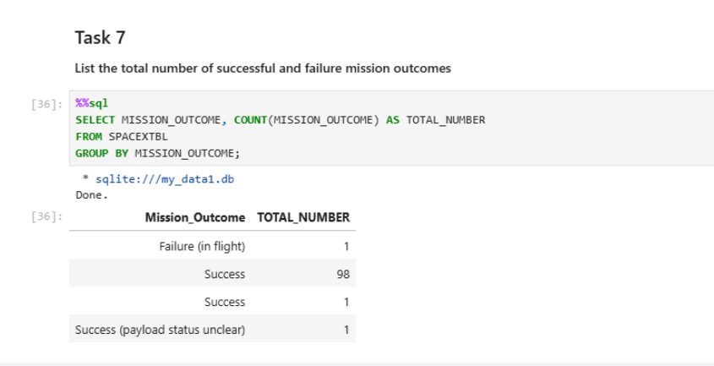
Total Number of Successful and Failure Mission Outcomes

Slide 31
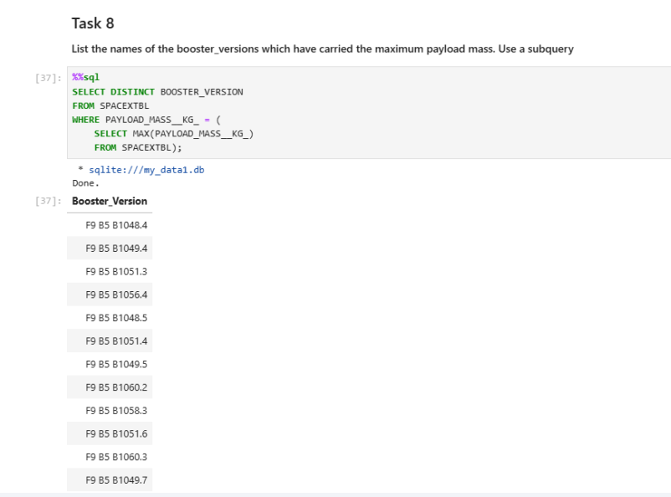
Boosters Carried Maximum Payload

Slide 32
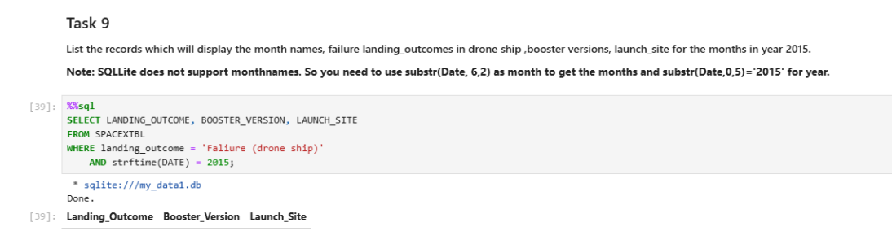
2015 Launch Records

Slide 33
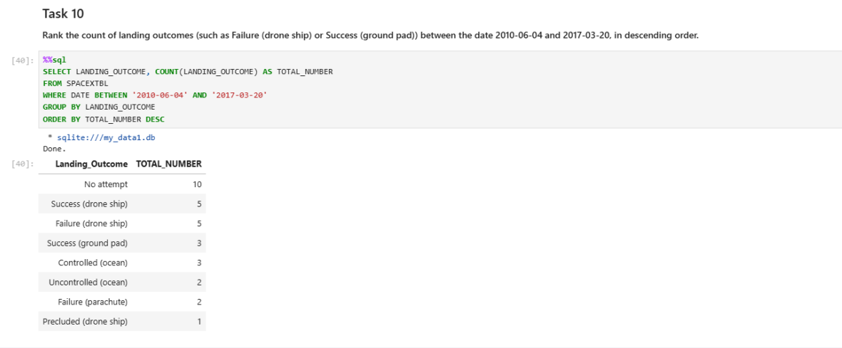
Rank Landing Outcomes Between 2010-06-04 and 2017-03-20

Slide 34

Section 3

Slide 35
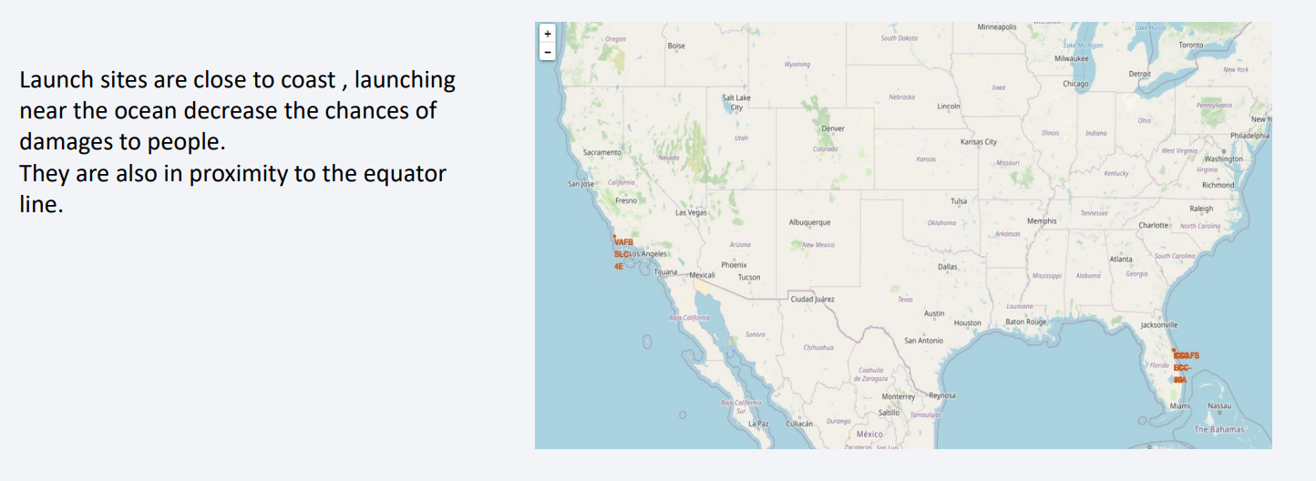
Location Marker on Map

Slide 36
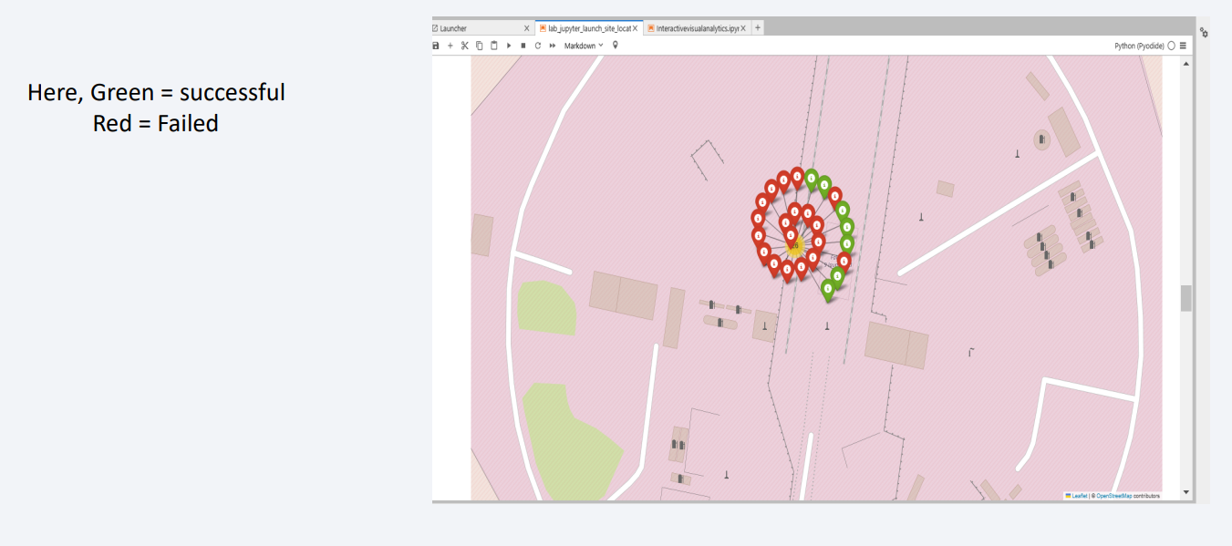
Colour-labeled launch records on the map

Slide 37
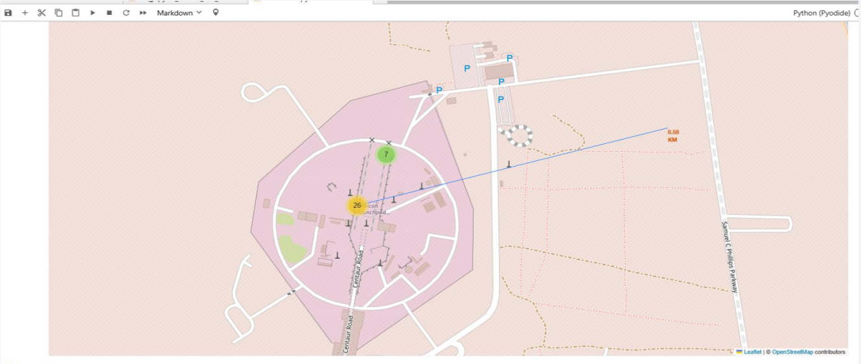
Distance from launch site to proximities

Slide 38

Section 4

Slide 39
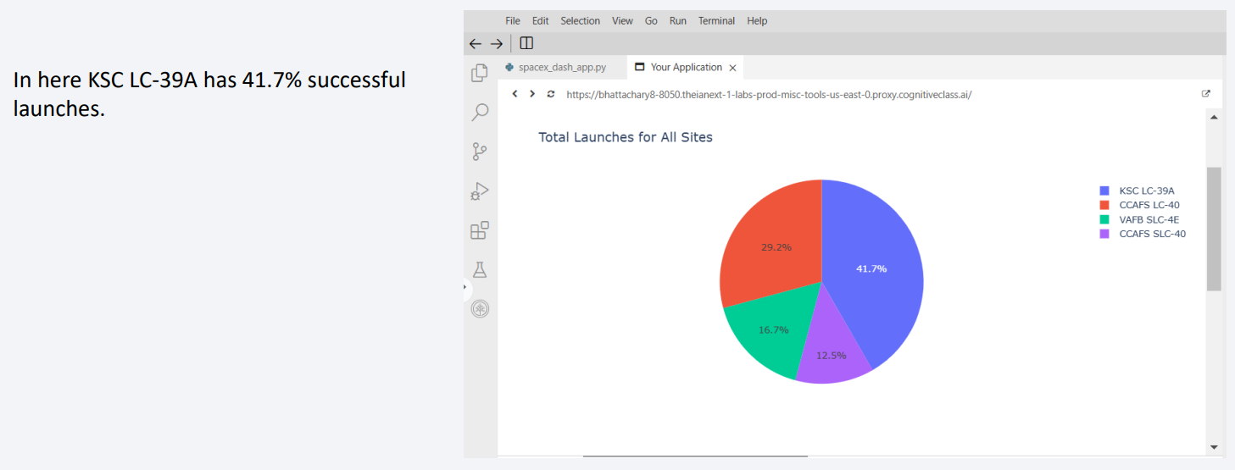
Total Launches for All Sites

Slide 40
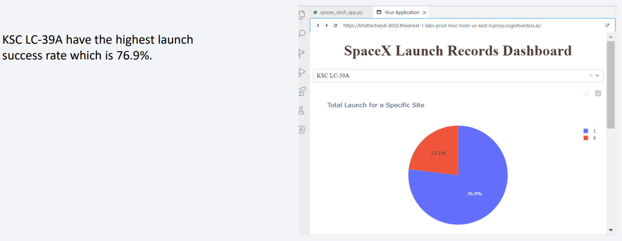
Site with Highest Launch Success Ratio

Slide 41
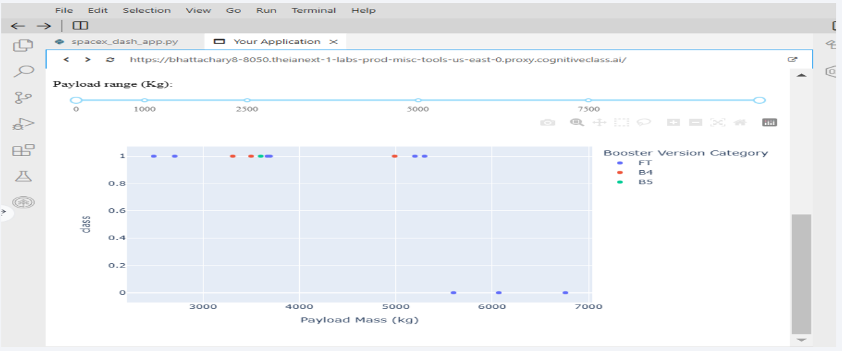
Range Slider

Slide 42

Section 5

Slide 43
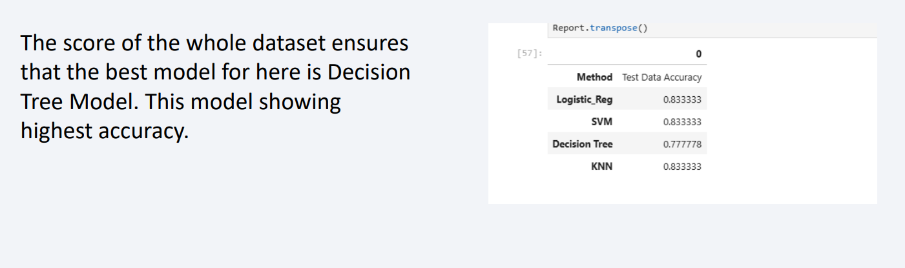
Classification Accuracy

Slide 44
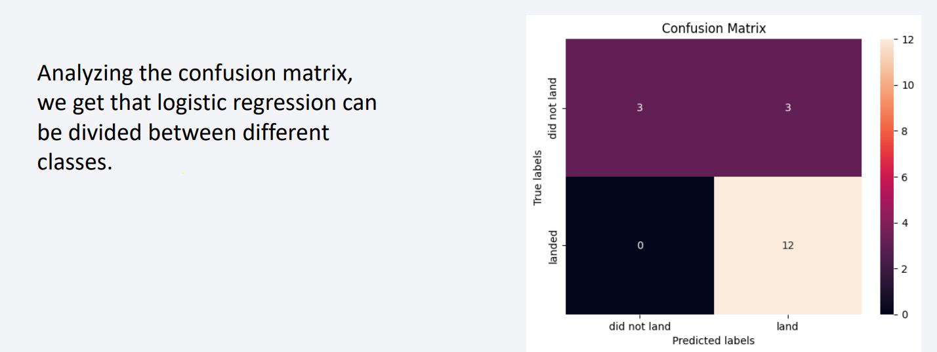
Confusion Matrix

Slide 45
Conclusions
KSC LC-39A has the highest success rate of all the launches.
The predictive model produced by decision tree algorithm gives the best result.
Success rate of launches increasing year after year.
Launches with a low payload mass show better results.

Slide 46


